Slide 1
Priority Encoder
Multiplexer

Slide 2
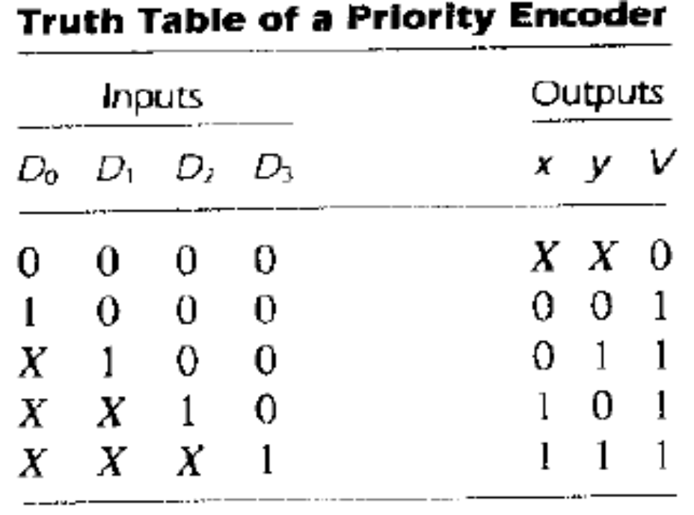
Priority Encoder
The operation of the priority encoder is such that if two or more inputs are equal to 1 at the same time, the input having the highest priority will take precedence.

Slide 3
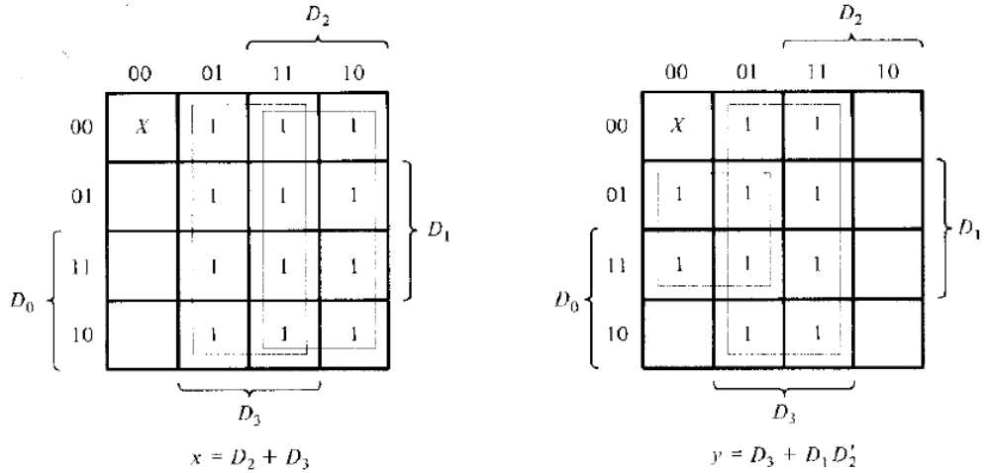
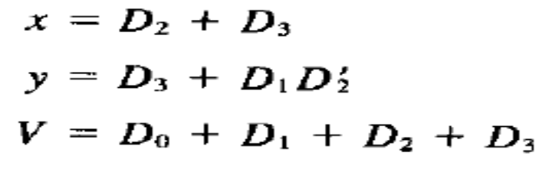
Maps for the Priority Encoder

Slide 4
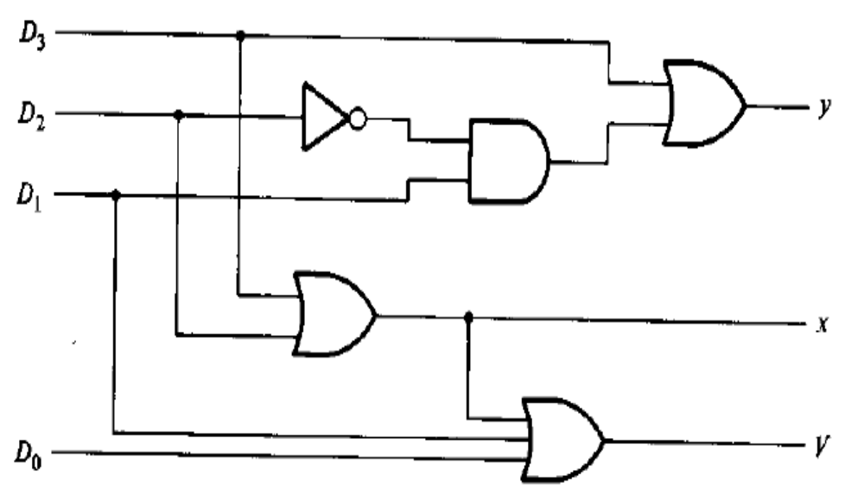
4-input Priority Encoder

Slide 5
Priority Encoder
Multiplexer

Slide 6
Multiplexers
Multiplexing – transmitting a large number of information units over a small number of channels or lines.
Multiplexer – a combinational circuit that selects binary information from one of many input lines and directs it to a single output line.
The selection of a particular input line is controlled by a set of selection lines.
Input lines – 2^{n}
Selection lines – n
Output line – 1

Slide 7
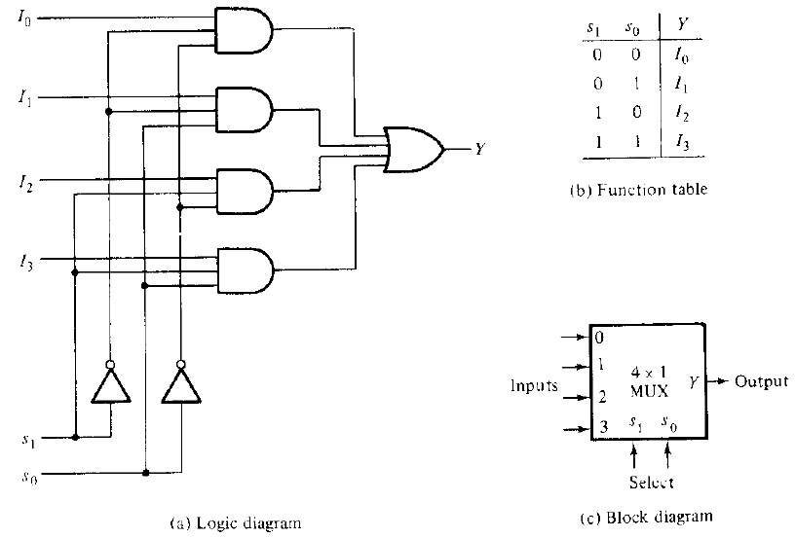
4 – to – 1 line multiplexer
V.Saritha@VIT University

Slide 8
Multiplexers
In general, a 2^{n} – to – 1 line multiplexer is constructed from an n – to – 2^{n} decoder by adding to it 2^{n} input lines, one to each AND gate.
The outputs of the AND gates are applied to a single OR gate to provide the 1-line output.

Slide 9
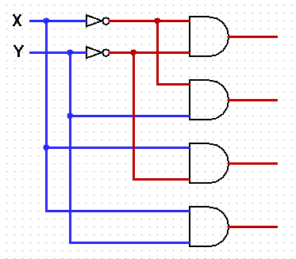
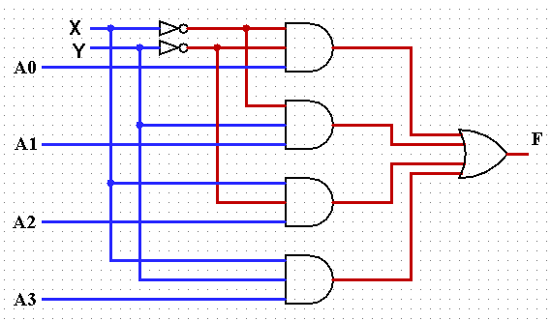
Multiplexers using Decoders
2 x 4 Decoder
4 x 1 Multiplexer

Slide 10
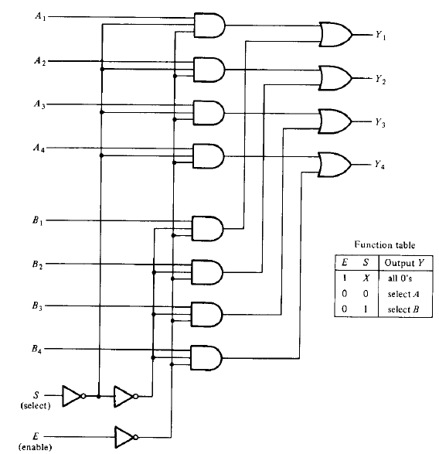
Quadruple 2 – to – 1 line Multiplexers
V.Saritha@VIT University

Slide 11
Boolean Function Implementation
The min terms out of the decoder to be chosen can be controlled with the input lines.
The minterms to be included with the function are chosen by making their corresponding input lines equal to 1
Those minterms not included in the function are disabled by making their input lines equal to 0.
This method implements the Boolean function of n variables with a 2^{n} – to – 1 multiplexer.

Slide 12
Example
F(A, B, C) = Σ(1, 3, 5, 6)
We require 8 x 1 Multiplexer
0
1
0
1
0
1
1
0
I₀
I₁
I₂
I₃
I₄
I₅
I₆
I₇
8 x 1
MUX
F
S₂ S₁ S₀
A B C

Slide 13
2nd Method for Boolean Function Implementation using Multiplexers
Boolean Function has n + 1 variables
Connect n variables to selection lines
The remaining single variable is used for the inputs of the multiplexer
If ‘A’ is this single variable, the inputs of the multiplexer are chosen to be either A or A′ or 1 or 0.
In this method, Boolean function of n + 1 variables is implemented using 2^{n} to 1 line MUX.

Slide 14
Procedure for implementing any Boolean function of n+1 variables using 2^{n} x 1 MUX
Express the function in its sum of minterms form.
Assume that the ordered sequence of variables is ABCD…
Connect right most n-1 variables as selection lines with B connected to the high-order selection line.
The first half of minterms have ‘A’ in complemented form and the second half have ‘A’ in its true form.
List all the minterms in two rows
First row
  List all those minterms where A is complemented
Second row
  List all those minterms where A is uncomplemented.

Slide 15
Inspect each column
If two minterms in a column are not circled, apply 0 to the corresponding multiplexer input.
If the two minterms are circled, apply 1 to the corresponding multiplexer input.
If the Bottom minterm is circled and the top is not circled, apply A to the corresponding multiplexer input.
If the top minterm is circled and the bottom is not circled, apply A′ to the corresponding multiplexer input

Slide 16
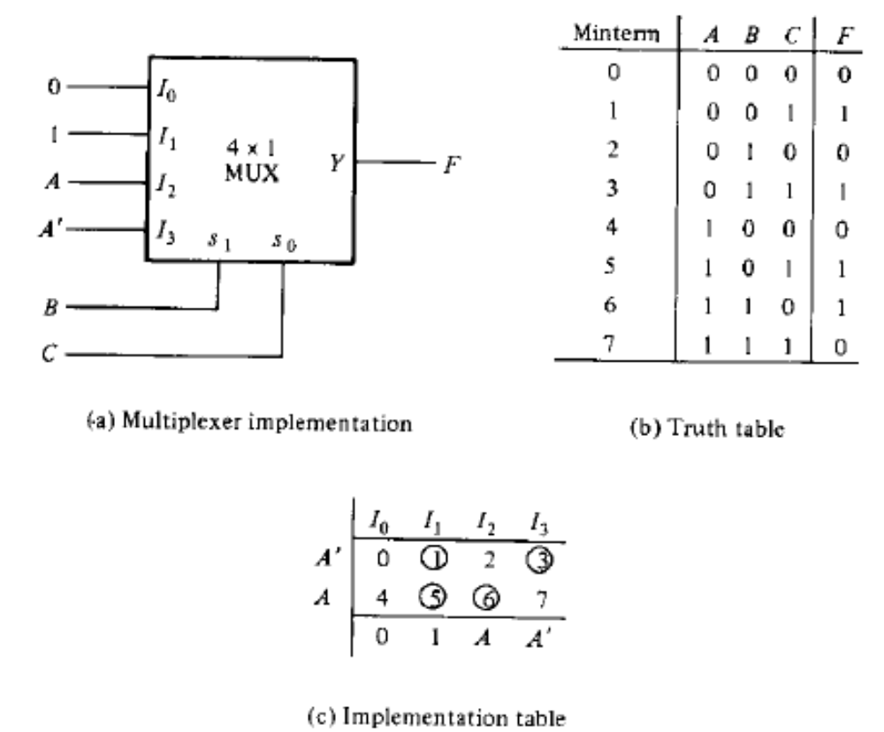
Example F = Σ(1, 3, 5, 6)

Slide 17
Examples
Implement using Multiplexers
  F (A,B,C,D)= Σ(0,1,3,4,8,9,15)
  F(A,B,C) = Σ(1,3,5,6) with C as input variable
  Construct 8 x 1 MUX with dual 4 line to 1 line mux having separate enable inputs but common selection lines. use a block diagram construction.

Slide 18
References
M.Morris Mano, “Digital Design”, 3rd Edition
M. Morris Mano and Michael D. Ciletti, “Digital Design”, 4th Edition, 2007

